Slide 1






EF Code First
Entity Framework DB From Code,
OOP Introduction
Code
First
SoftUni Team
Technical Trainers
Software University
http://softuni.bg

Slide 2


Table of Contents
EF Modelling Workflows
Introduction to OOP
EF Component Objects
Configuration Files and Code

Slide 3
Questions
sli.do #Entity

Slide 4
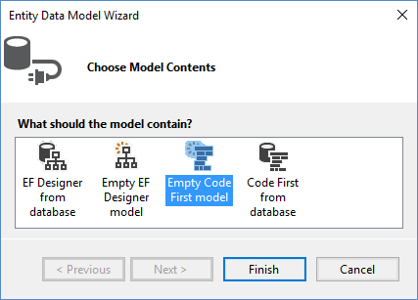
Modeling Workflows
Motivation for Code First approach

Slide 5
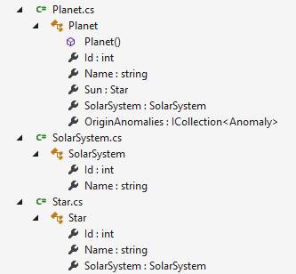
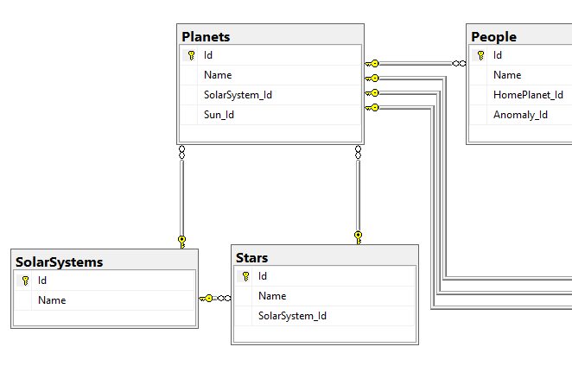
What is Code First?
Code First means to write the .NET objects and let Entity Framework create the database from the mappings

Slide 6
Why Use Code First?
Write code without having to define mappings in XML or create database models
Define objects in C# format
Enables database persistence with no configuration
Changes to code are automatically reflected in the schema
Can use data annotations (Key, Required, etc.)

Slide 7
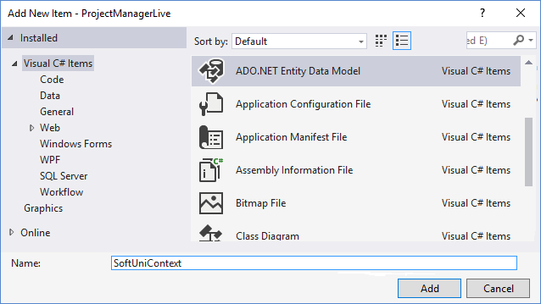
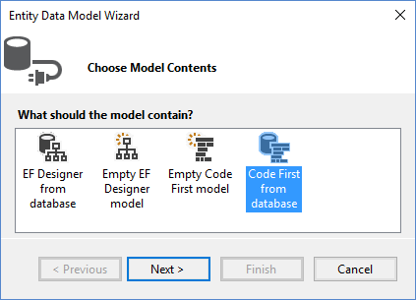
Code First from DB in Visual Studio
To add EF support to a project in Visual Studio:
Select Add → New Item… from the project's context menu
Chose
"Code First"
Select ADO.NET

Slide 8
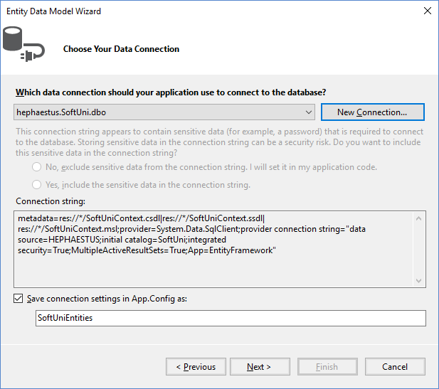
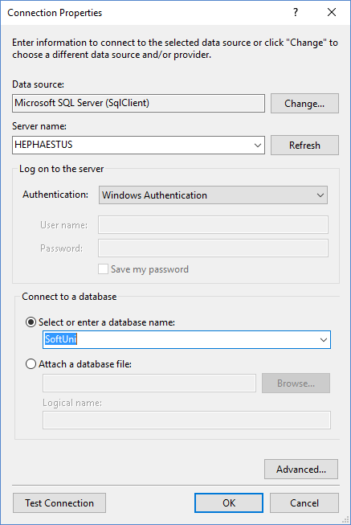
Code First from DB in Visual Studio(2)
Pick server
Select after creating
Pick database

Slide 9
Empty Code First in Visual Studio
Starting with a database will create initial classes
When creating an empty Code First project, we have to write everything from scratch
Empty model

Slide 10
Methods
Methods are named pieces of code that can be reused
When differentiated by their signature can be overloaded
Method name
List of parameters
Signature
int GetArea (int width, int height) {
int area = width * height;
return area;
}
Return
data type
Method
body
Return statement

Slide 11
Classes in C#
Classes describe the structure of real-world objects
Properties of classes hold information about the modeled object relevant to the problem
The class Constructor is used to initialize values of properties
Access modifiers specify who can see the class and its individual members (by default, everything is private)

Slide 12

Simple Class Definition
Class name
public class Cat {
public Cat(string name, string color)
{
this.Name = name;
this.Color = color;
}
public string Name { get; set;}
public string Color { get; set; }
}
Constructor
Properties
Access modifiers

Slide 13
Constructor Chaining
Overloaded constructors can be chained
public class IceCream {
public IceCream(string flavour, int scoops)
{
this.Flavour = flavour;
this.Scoops = scoops;
}
public IceCream()
: this("Vanilla", 3) {}
public string Flavour { get; set;}
public int Scoops { get; set; }
}
Overload with default values

Slide 14
Fields
Fields store information and are usually private
Can be combined with properties for validation
public class Person {
private int age;
public string Name { get; set;}
public int Age {
get { return this.age; }
set {
if (value < 0) { throw new InvalidArgumentException(); }
this.age = value;
}
}
}
Private field
Public property
Validation

Slide 15
Static vs. Instance
Static members are attached to the class definition
They can be used without an instance
All instances will have the same value for static fields and props
Instance members are attached to individual object instances
An instance must be initialized with new before use
Each instance has it's own values
var date = new DateTime();
Console.Log(date.DayOfWeek);
Static method
Instance property

Slide 16

Entity Framework Components
DbContext
DomainObject
DomainObject
Overview of system objects

Slide 17
Domain Classes (Models)
Bunch of normal C# classes (POCO)
May contain navigation properties for table relationships
Recommended to be in a separate class library
public class PostAnswer
{
public int PostAnswerId { get; set; }
public string Content { get; set; }
public int PostId { get; set; }
public virtual Post Post { get; set; }
}
Primary key
Foreign key
Virtual for lazy loading
Navigation property

Slide 18
Domain Classes (Models) (2)
Another example of domain class (model)
public class Post
{
private ICollection<PostAnswer> answers;
public Post()
{
this.answers = new HashSet<PostAnswer>();
}
public virtual ICollection<PostAnswer> Answers
{
get { return this.answers; }
set { this.answers = value; }
}
public PostType Type { get; set; }
}
Prevents
NullReferenceException
Navigation property
Enumeration

Slide 19
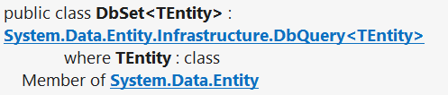
DbSet Type
Collection of single entity type
Set operations: Add, Attach, Remove, Find
Use with DbContext to query database
public DbSet<Post> Posts { get; set; }

Slide 20
The DbContext Class
A class that inherits from DbContext
Manages model classes using DbSet<T> type
Implements identity tracking, change tracking
Provides API for CRUD operations and LINQ-based data access
Recommended to be in a separate class library
Don't forget to reference the Entity Framework library
Use several DbContext if you have too much models

Slide 21
Defining DbContext Class – Example
EF Reference
using System.Data.Entity;
using CodeFirst.Models;
public class ForumContext : DbContext
{
public DbSet<Category> Categories { get; set; }
public DbSet<Post> Posts { get; set; }
public DbSet<PostAnswer> PostAnswers { get; set; }
public DbSet<Tag> Tags { get; set; }
}
Namespace containing our models

Slide 22
CRUD Operations with EF Code First
var db = new ForumContext();
var category = new Category { Name = "Database course" };
db.Categories.Add(category);
var post = new Post();
post.Title = "Homework Deadline";
post.Content = "Please extend the homework deadline";
post.Type = PostType.Normal;
post.Category = category;
post.Tags.Add(new Tag { Text = "homework" });
post.Tags.Add(new Tag { Text = "deadline" });
db.Posts.Add(post);
db.SaveChanges();

Slide 23
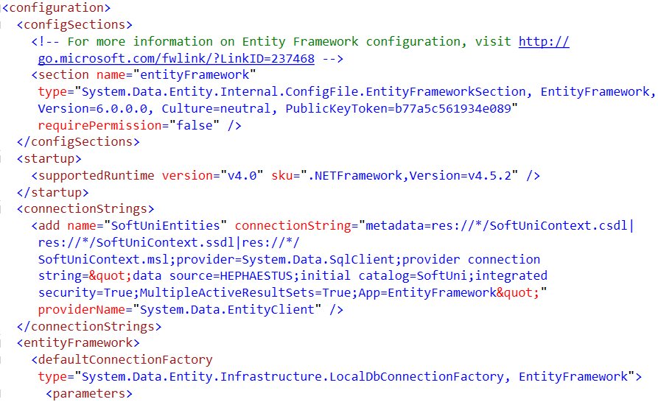
Entity Framework Configuration
Using Config Files and Code

Slide 24
Where is My Data?
Default App.config file contains link to default connection factory
Server name by default:
(localdb)\v11.0 or (localdb)\MSSQLLocalDB
We can use VS server explorer to view database
<entityFramework>
<defaultConnectionFactory type="System.Data.Entity. Infrastructure.LocalDbConnectionFactory, EntityFramework">
<parameters>
<parameter value="v11.0" />
</parameters>
</defaultConnectionFactory>
</entityFramework>

Slide 25
How to Connect to SQL Server?
First, create a context constructor that calls the base constructor with connection name
Then add the connection string in app.config
public class ForumContext : DbContext
{
public ForumContext() : base("ForumDb") { … }
…
}
<connectionStrings>
<add name="ForumDb" connectionString="Data Source=.;
initial catalog=ForumDb;Integrated Security=True"
providerName="System.Data.SqlClient" />
</connectionStrings>

Slide 26
Database Connection Workflow
Connection String Available?
Yes
No
Database Exists?
Yes
Build String (SQL Server Express or Create Local DB)
Use Database
No
Create Database

Slide 27
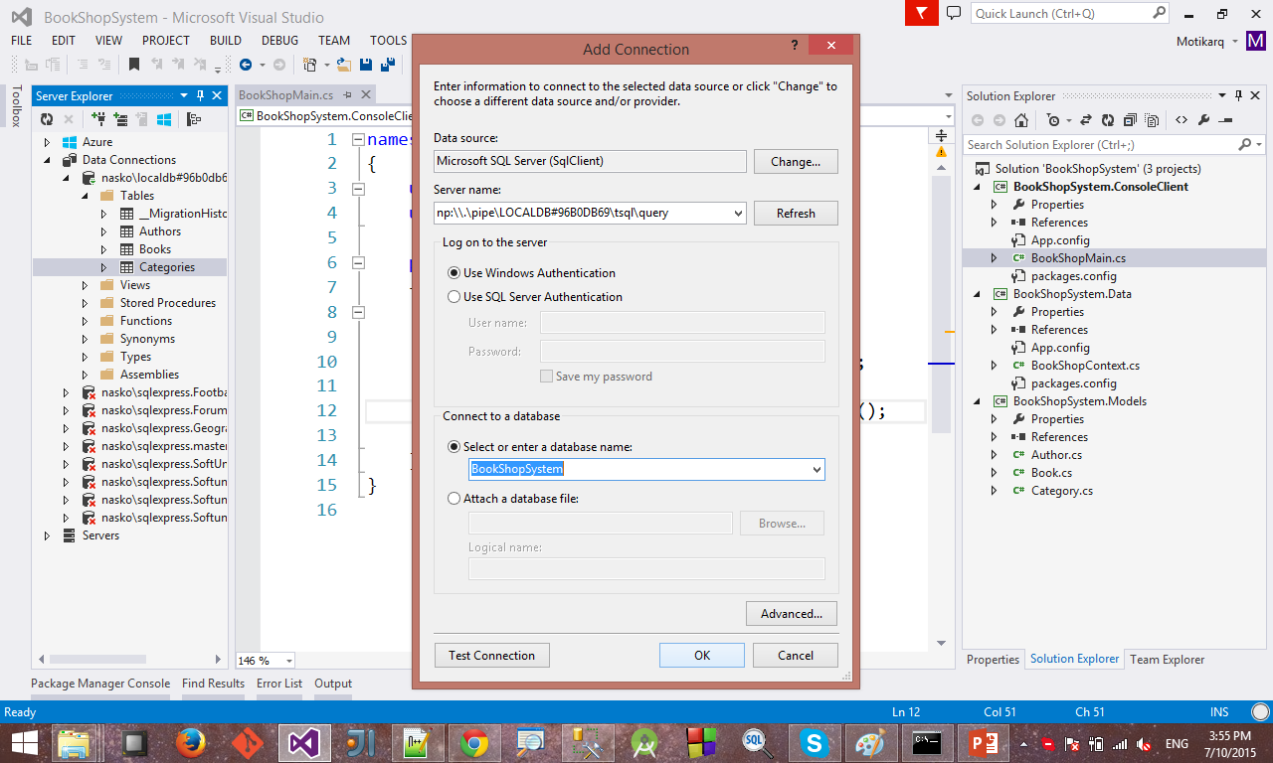
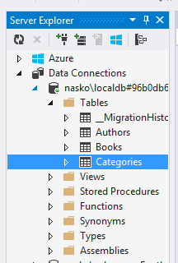
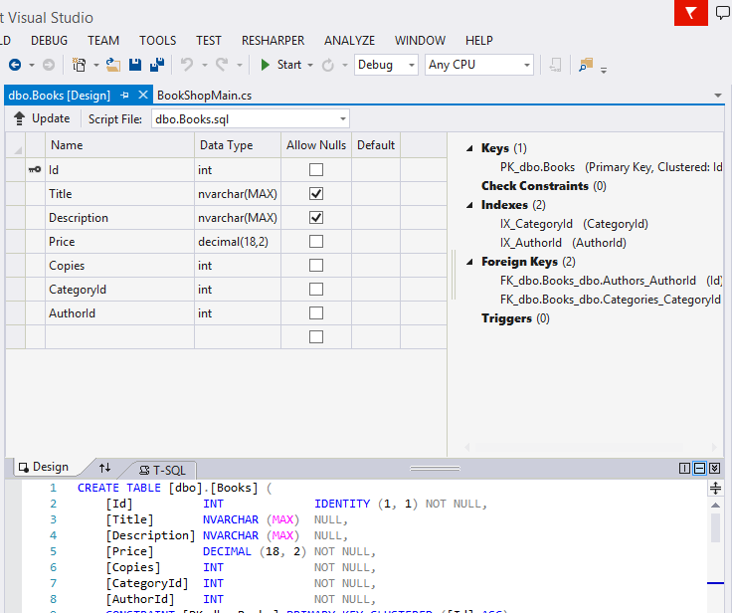
Connecting to LocalDB in Visual Studio
Connecting to LocalDB:
http://stackoverflow.com/a/21565688

Slide 28

Summary
Code First increases productivity by centralizing maintenance
Classes represent real world objects with their properties and behaviour
Entity Framework uses data classes (POCOs) to represent DB objects
We can change EF settings trough config files without recompiling the code

Slide 29








Entity Framework Code First
https://softuni.bg/courses/

Slide 30
License
This course (slides, examples, demos, videos, homework, etc.) is licensed under the "Creative Commons Attribution-NonCommercial-ShareAlike 4.0 International" license
Attribution: this work may contain portions from
"Databases" course by Telerik Academy under CC-BY-NC-SA license

Slide 31




Free Trainings @ Software University
Software University Foundation – softuni.org
Software University – High-Quality Education, Profession and Job for Software Developers
softuni.bg
Software University @ Facebook
facebook.com/SoftwareUniversity
Software University Forums
forum.softuni.bg

